Slide 1
Cidadania 4.0
Matheus Souza matheus.souza@sap.com

Slide 2
SAP Labs
Latin America
Culture of Innovation
@ SAP Labs Latin America.
Matheus Souza matheus.souza@sap.com

Slide 3
O que é
CIDADANIA 4.0
?

Slide 4
Insert page title (sentence case)
Indústria 4.0
Indústria 1.0
Indústria 2.0
Indústria 3.0
Indústria 4.0
First level
Second level
Third level
NOTE: Delete the yellow stickers when finished.
The text placeholders have different, preformatted text levels. Each level has different formatting (font size, indent, bullet).
To jump between the preformatted text levels, use the Increase List Level and Decrease List Level buttons in the Paragraph toolbar.
Type your text in the placeholder.
Click the Increase List Level button in the Paragraph toolbar to go to the next level.
If you need a bullet list, choose level 2.
Avoid working with spaces, other bullets, or bullets in the wrong level. Only when you use the right levels it is possible to reset the slide layout.
Mecanização
Tear
Força à vapor
Escala
Linhas
Energia
Combustão
Automação
Robótica
Internet
Sistemas
IoT
Redes
AI/ML

Slide 5
HUMANOS NECESSITAM
TECNOLOGIA ENTREGA

Slide 6
Insert page title (sentence case)
Cidadania 4.0
Cidadania 1.0
Cidadania 2.0
Cidadania 3.0
Cidadania 4.0
First level
Second level
Third level
NOTE: Delete the yellow stickers when finished.
The text placeholders have different, preformatted text levels. Each level has different formatting (font size, indent, bullet).
To jump between the preformatted text levels, use the Increase List Level and Decrease List Level buttons in the Paragraph toolbar.
Type your text in the placeholder.
Click the Increase List Level button in the Paragraph toolbar to go to the next level.
If you need a bullet list, choose level 2.
Avoid working with spaces, other bullets, or bullets in the wrong level. Only when you use the right levels it is possible to reset the slide layout.
Nômades
Caça
Coleta
Sobreviver
Feudalismo
Cultivo
Agricultura
Proteção
República
Bens
Serviços
Direitos
Deveres
Segurança
Saúde
Educação
Transporte

Slide 7
Insert page title (sentence case)
Cidadania 4.0
Cidadania 1.0
Cidadania 2.0
Cidadania 3.0
Cidadania 4.0
First level
Second level
Third level
NOTE: Delete the yellow stickers when finished.
The text placeholders have different, preformatted text levels. Each level has different formatting (font size, indent, bullet).
To jump between the preformatted text levels, use the Increase List Level and Decrease List Level buttons in the Paragraph toolbar.
Type your text in the placeholder.
Click the Increase List Level button in the Paragraph toolbar to go to the next level.
If you need a bullet list, choose level 2.
Avoid working with spaces, other bullets, or bullets in the wrong level. Only when you use the right levels it is possible to reset the slide layout.
Nômades
Caça
Coleta
Sobreviver
Feudalismo
Cultivo
Agricultura
Proteção
República
Bens
Serviços
Direitos
Deveres
Segurança
Saúde
Educação
Transporte
Educação 4.0
Representação
Engajamento
Inteligência

Slide 8
Educação 4.0 Inovação e Empreendedorismo de Base

Slide 9
Representação Diversidade, Coletividade & Individualidade

Slide 10
Engajamento Transparência e Influência em tempo real

Slide 11
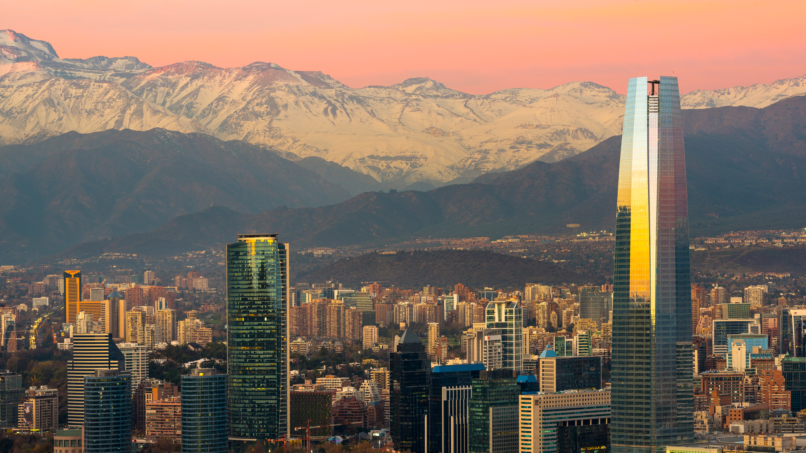
Inteligência Ações baseadas em análise de dados

Slide 12
POR
ONDE
COMEÇAR?

Slide 13
PENSAR FAZER

Slide 14
Obrigado.
Matheus Souza
matheus.souza@sap.com

