Slide 1
ECOSYSTEMS OF INNOVATION AND THE ROLE OF THE GOVERNMENT
Josep M. Pique
jmpique@TechnovaBarcelona.org
@JosepMPique

Slide 2
AGENDA
BRIDGING THE GAP
OPEN INNOVATION & OPEN GOVERNMENT
THE DEMAND SIDE OF ECOSYSTEMS OF INNOVATION
CANDY INNOVATON MODEL
CONCLUSIONS

Slide 3
1.- BRIDGING THE GAP

Slide 4
1.1.- BRIDGING DE GAP
People
Bridging
Opportunity
Value
Tech
Money
ECOSYSTEM INNOVATION
Source: Jerry Engel, Josep Pique & Itxaso del Palacio, 2010.

Slide 5
1.2.- ADDING TECHNOLOGY VALUE
Market Introduction
Regulatory Approvals
Value
Manufacturing Prototype
Working Prototype
Patent Application
Feasibility or Prototype
Concept
Time
Source: Jerry Engel, Josep Pique & Itxaso del Palacio, 2010.

Slide 6
1.3.- ADDING MARKET VALUE
Backlog
Satisfied Customers
Market Launch
Beta Test
Value
Technical Reports Published
Surveys/Concept Testing
Qualitative Research (Focus Groups)
Market Analysis - Published Data
Time
Source: Jerry Engel, Josep Pique & Itxaso del Palacio, 2010.

Slide 7
1.4.- VALUATION IN STEPS
Predictable Scale
Scale Validated
Market Traction
Early Validation
I
II
III
IV
Concept Defined
Time
Source: Jerry Engel, Josep Pique & Itxaso del Palacio, 2010.

Slide 8
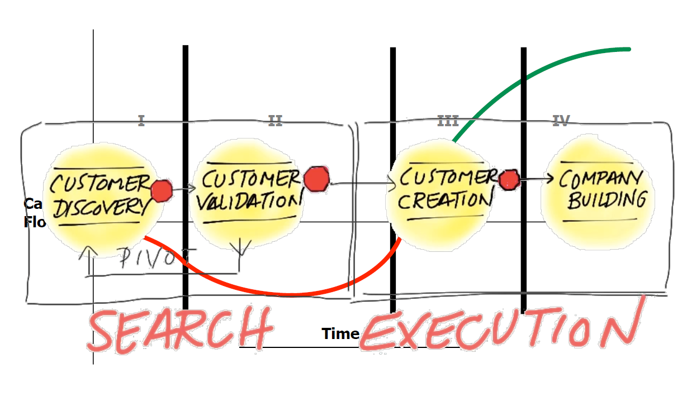
1.5.- FROM BUSINESS PLAN TO BUSINESS MODEL
Source: Jerry Engel – Steve Blank 2015

Slide 9
2.- OPEN INNOVATION &
OPEN GOVERNMENT

Slide 10
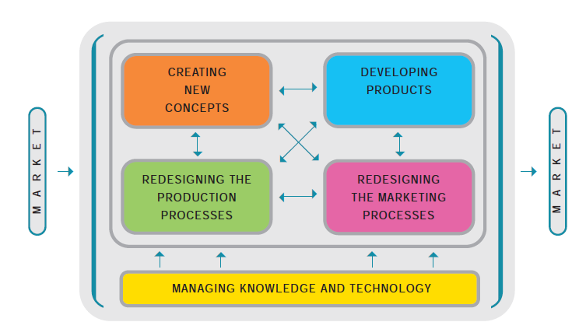
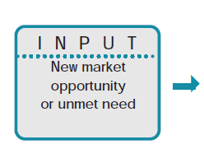
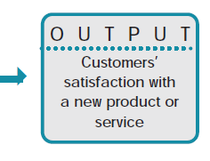
2.1.- INTERNAL INNOVATION

Slide 11
2.2.- MANAGING THE OPEN INNOVATION

Slide 12
2.3.- GLOBAL INNOVATION ECOSYSTEM
Global
National
Regional
Local
 | Science | Technology | Industry | Market
International
Innovation
Source: Francesc Solé Parellada, Josep Piqué & Joan Bellavista. 2007.

Slide 13
2.4.- OPEN INNOVATION TOOLKIT
 |  | Location
 |  | Internal | External
Fit | Aligns with Core | Internal Development | Acquisition
 | Non-core | New Business | Investment
Source: Jerry Engel, 2011

Slide 14
2.4.- OPEN INNOVATION TOOLKIT
 |  | Location
 |  | Internal | External
Fit | Aligns with Core | Internal Development | Acquisition
 | Non-core | New Business | Investment
Source: Jerry Engel, 2011

Slide 15
2.4.- OPEN INNOVATION TOOLKIT
 |  | Location
 |  | Internal | External
Fit | Aligns with Core | Business Unit Champions | Acquisition
 | Non-core | New Business | Investment
Source: Jerry Engel, 2011

Slide 16
2.4.- OPEN INNOVATION TOOLKIT
 |  | Location
 |  | Internal | External
Fit | Aligns with Core | Business Unit Champions | Sourcing Tech “Scouts”
 | Non-core | New Business | Investment
Source: Jerry Engel, 2011

Slide 17
2.4.- OPEN INNOVATION TOOLKIT
 |  | Location
 |  | Internal | External
Fit | Aligns with Core | Business Unit Champions | Sourcing Tech “Scouts”
 | Non-core | Outside Experts Entrepreneurs | Investment
Source: Jerry Engel, 2011

Slide 18
2.4.- OPEN INNOVATION TOOLKIT
 |  | Location
 |  | Internal | External
Fit | Aligns with Core | Business Unit Champions | Sourcing Tech “Scouts”
 | Non-core | Outside Experts Entrepreneurs | Corporate VC Venture Capital
Source: Jerry Engel, 2011

Slide 19
3.- THE DEMAND SIDE OF ECOSYSTEMS OF INNOVATION

Slide 20
3.1.- TRIPLE HELIX + DEMAND
Government
Quadruple Helix
Tax & Law
Organization
Public Procurement
Demand Side
Market Needs
Challenges
University
Industry
Education
Research
Transfer
Corporation
SME
New
Source: Josep Pique, Montse Pareja & Luis Sanz, 2014.

Slide 21
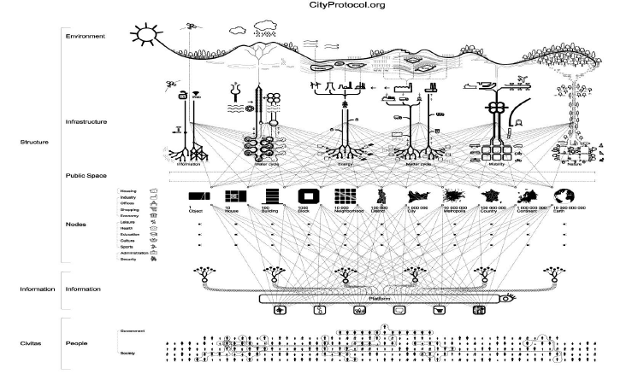
3.2.- DEMAND: PUBLIC CHALLENGES

Slide 22
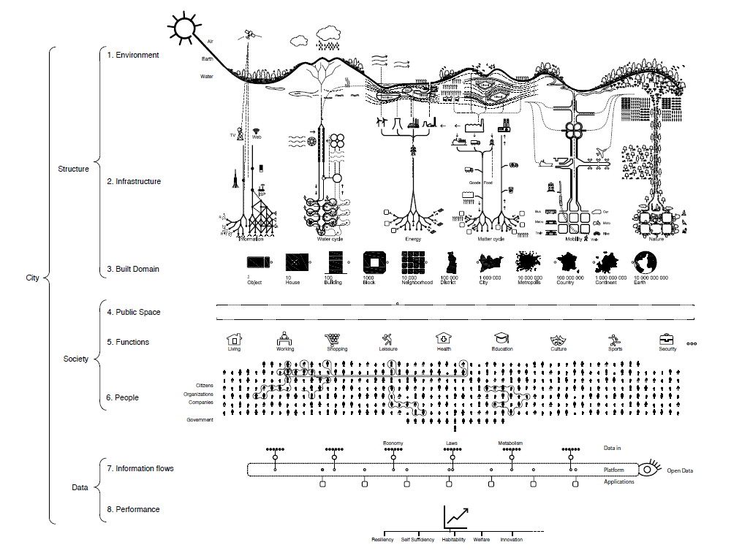
3.3.- DEMAND: PUBLIC CHALLENGES
ENVIRONMENT
IT
WATER
ENERGY
WASTE
MOBILITY
NATURE
CITY DIMENSION
PUBLIC SPACE PÚBLIC
SERVICES
OPEN GOVERNMENT
INFORMATION

Slide 23
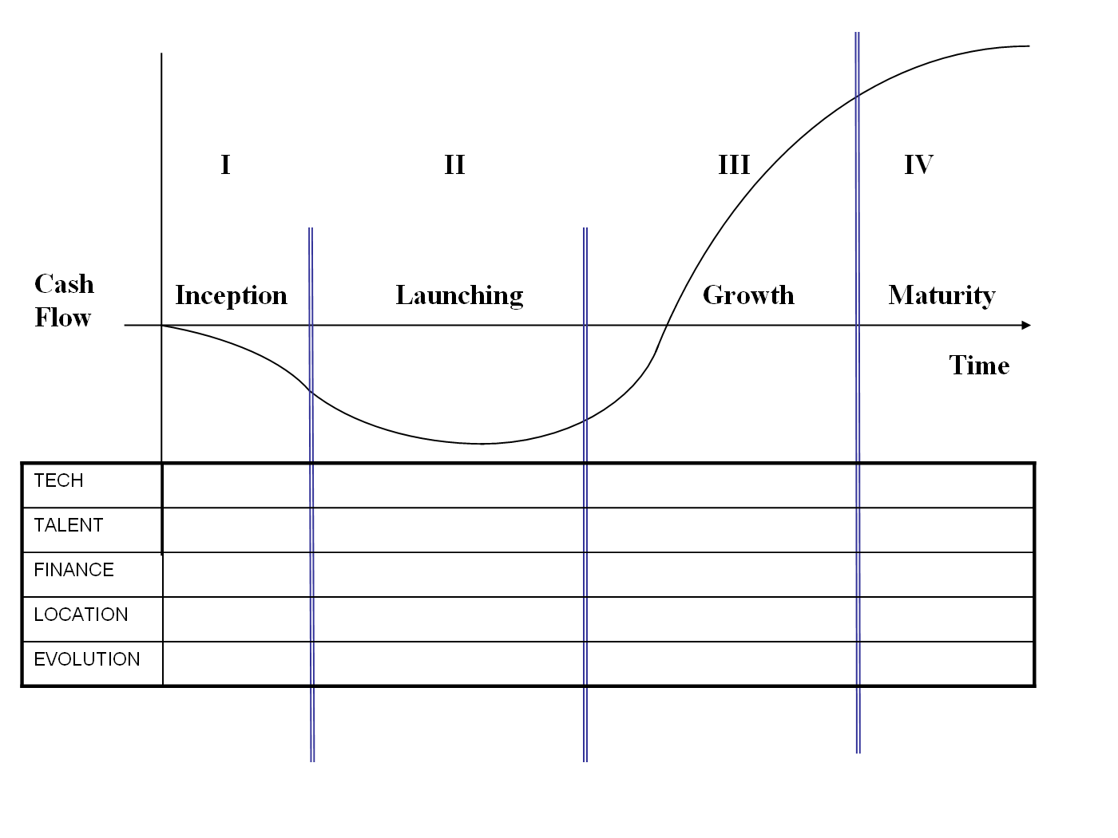
3.4.- ROLES IN THE PATH TO GROW
University
Industry
Government
Source: Henry Etzkowitz, Francesc Solé Parellada & Josep Piqué. 2007.

Slide 24
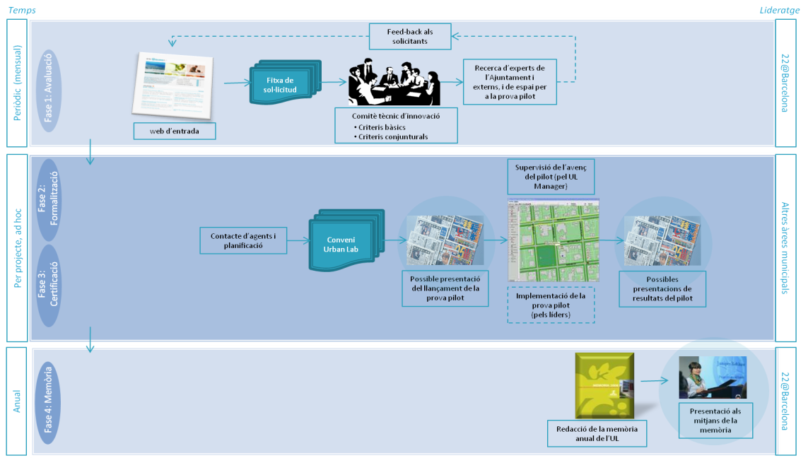
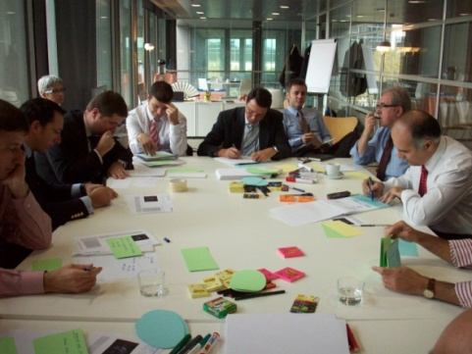
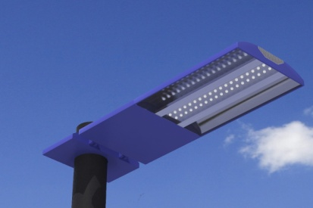
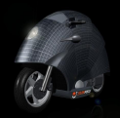
3.5.- PUBLIC LAB: PROCESS
Led

Slide 25
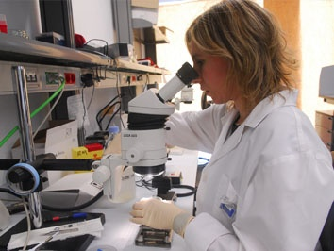
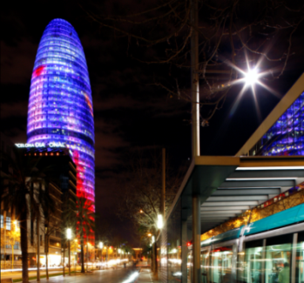
3.6.- PUBLIC LAB: LOCAL AND GLOBAL
Local and Global
From local to global
(internationalization)
and from global to local
(foreing investment attraction) ...
SCIENCE AND TECNOLOGY
CITY, MARKET
COMPANIES, INDUSTRY

Slide 26
4.- CANDY MODEL

Slide 27
CANDY INNOVATION MODEL
CANDY INNOVATION MODEL
F
I
L
T
E
R
I
I
F
I
L
T
E
R
I
F
I
L
T
E
R
I
I
I
A.
CHALLENGES
C. DEVELOPMENT
D.
SCALING
B. IDEAS

Slide 28
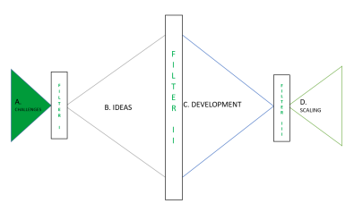
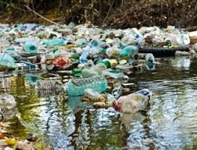
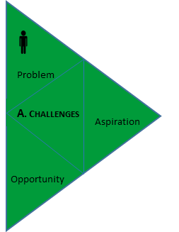
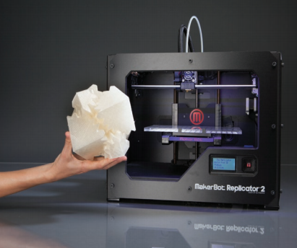
4.1.- CHALLENGES
user participation

Slide 29
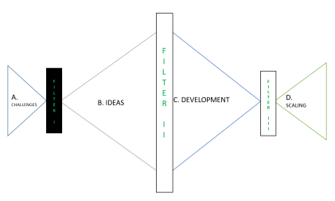
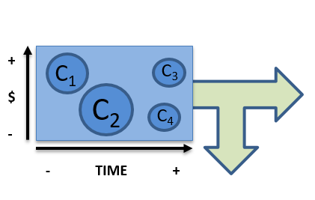
4.2.- FILTERS OF CHALLENGES
FILTER
I

Slide 30
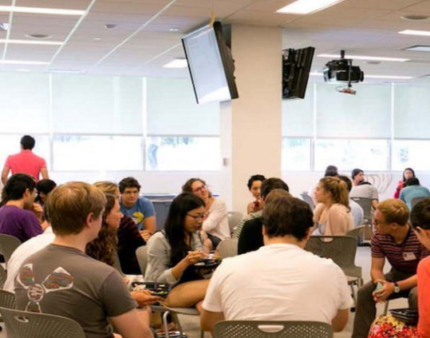
i-lab HARVARD
 | The i-lab is a unique collaboration and education space designed to foster entrepreneurship and innovation across Harvard University. i-Labs is divided into Explore, Meet, Ideate, Prototype+Build and Launch+Growth. Explore is stimulating the community with daily events, including training, workshops and hackathons. https://i-lab.harvard.edu

Slide 31
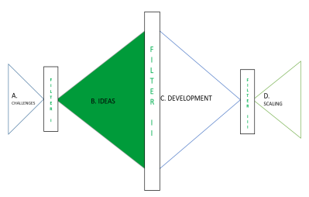
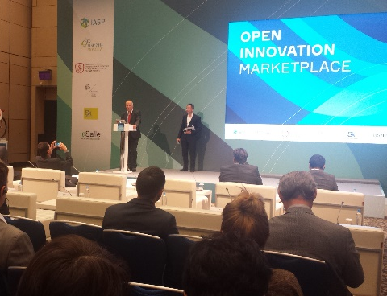
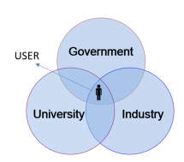
4.3.- IDEAS
Open Call
Call for solutions
Ex: Open Challenge
Internal/External
Workshop
B. IDEAS
Ecology of innovation
Ecosystem
EX: Lab
user participation

Slide 32
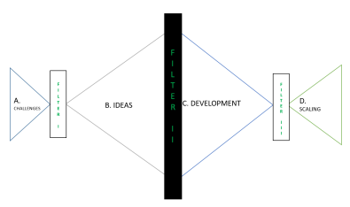
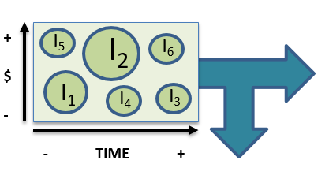
4.4.- FILTER OF IDEAS
FILT
E
R
I
I

Slide 33
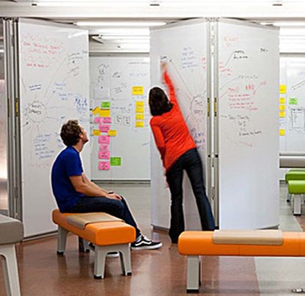
STANFORD d.school
 | d.school is a place for explorers & experimenters at Stanford University 8 core abilities: Navigate Ambiguity Learn from others Synthesize Information Experiment Rapidly Move Between Concrete and Abstract Build and Craft Intentionally Communicate Deliberately Design your Design Work https://dschool.stanford.edu

Slide 34
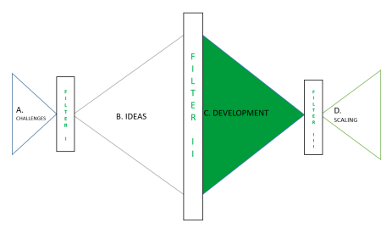
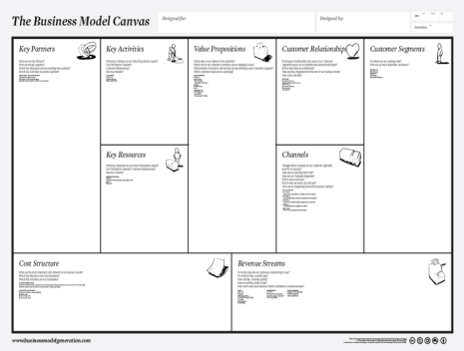
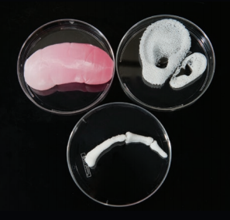
4.5.- DEVELOPMENT
Concept
Validation
Innovation
Canvas
C. DEVELOPMENT
Prototyping
user participation

Slide 35
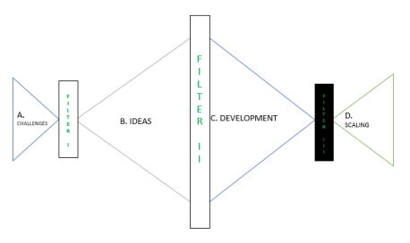
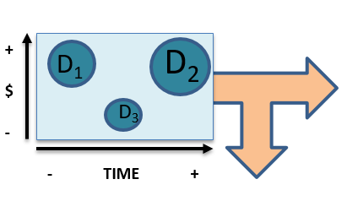
4.6.- FILTER OF DEVELOPMENTS
F
I
L
T
E
R
I
I
I

Slide 36
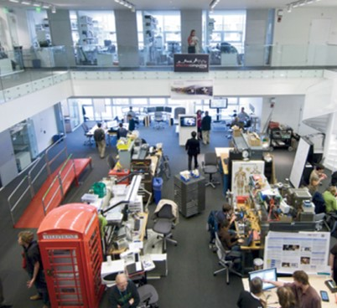
MIT MEDIA LAB & CBA
 | MIT Media Lab researchers design technologies for people to create a better future. MIT’s Center for Bits and Atoms (CBA) manages a research facility for making and measuring things on length scales from atoms to buildings Fab Labs provide widespread access to modern means for invention. They began as an outreach project from MIT's CBA. http://fab.cba.mit.edu/

Slide 37
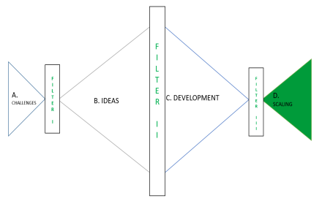
4.7.- SCALING
Local
D. SCALING
International

Slide 38
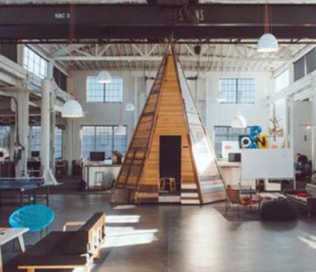
LIVING LABS
 | Living Labs (LLs) are defined as user-centred, open innovation ecosystems based on systematic user co-creation approach, integrating research and innovation processes in real life communities and settings. That’s the place where validate and show the result of innovation. http://openlivinglabs.eu/

Slide 39
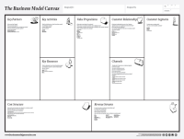
CANDY INNOVATION MODEL
FILT
E
R
I
I
Open Call
Call for solutions
Ex: Open Challenge
Concept
Validation
FILTE
R
I
F
I
L
T
E
R
I
I
I
Problem
Local
A. CHALLENGES
Aspiration
Internal/External
Workshop
Innovation
Canvas
D. SCALING
B. IDEAS
C. DEVELOPMENT
International
Opportunity
Ecology of innovation
Ecosystem
EX: Lab
Prototyping
user participation

Slide 40
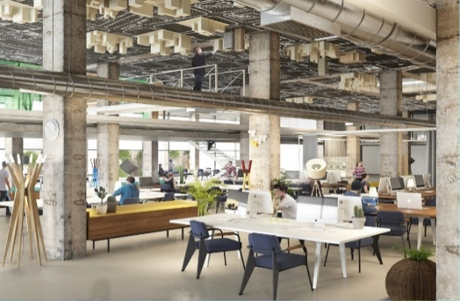
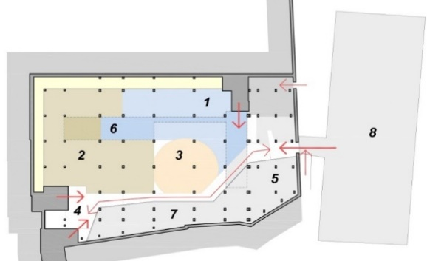
LA SALLE
 | La Salle is developing a Transversal Project that takes advantage of the entire Knowledge Ecosystem of the Campus: Groups of Research, Teaching and Technova. Serving businesses, entrepreneurs, universities, public administration and society in general - Local and International
Creativity Room Maker Space CitiLab Visits Transferring Room Meeting Rooms Facilities Congress Room
This project has been financed in 50% by the European Regional Development Funds of the European Union in the framework of the ERDF Operational Programme for Catalonia 2014-2020

Slide 41
5.- CONCLUSIONS

Slide 42
CONCLUSIONS – BENEFITS FOR TARGETS
Citizens: More and better products and solutions for better municipal services.
Businesses: Real-life testing space for easier market access. Learn, shorten time to market and increase their competitiveness.
Science and Technology: It’s a powerful tool for technology transfer, both locally and internationally.
Public administration: Facilitate the introduction of new solutions. Innovation as a brand related to Barcelona. Transparency and efficiency in public procurement.

Slide 43
CONCLUSIONS – SOME TIPS
Multidisciplinary work teams: Involve the “owner” or “owners” from the very beginning (definition of challenge, member of the jury, management of the implementation)
Open to any ideas vs. calls related to specific Challenge: Be sure is balanced. Take into account: the effort you can put in this process (€, HR, …), the type of solution you are looking for and the timing.
Solutions vs Challenges: Don’t ask for a solution, expose a challenge to be solve.
Legal aspects: Be sure that you take into account the legal framework for “buying innovation” in your country. From the first moment decide if you are looking for ideas, if you want to pilot or you are willing to buy a product/service.

Slide 44
CONCLUSIONS - PROCESS
The Discovery process based on Challenges
Filtering as soon as you can
Systematization of the Ideation
Prototyping
Business Model
Learning Local & Growing Global

Slide 45
THANK YOU !
Josep M. Pique
jmpique@TechnovaBarcelona.org
@JosepMPique

